Slide 1


18th March 2024
CryptoGraphy

Slide 2

Introduction
Cryptography is the art and science of keeping information secret. It is used to protect sensitive information from unauthorized access, use, disclosure, disruption, modification or destruction.
Key Concepts in Cryptography​
Plain Text: This is the original, readable message or data before encryption.​
Cipher: An algorithm that changes plain text into unreadable ciphertext.​
Cipher Text: The encrypted form of plain text created using an encryption algorithm and key.​
Key: A secret value used to control encryption and decryption.​
Encryption: Turning plain text into ciphertext using an encryption algorithm and key.​
Decryption: Changing ciphertext back into plain text using the same algorithm and key.​
Cryptosystem: A complete system for encryption and decryption, including the cipher, key, and usage protocols.

Slide 3

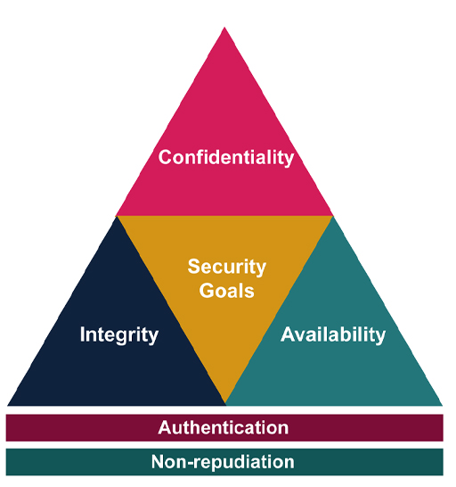
Features
Confidentiality: Ensuring only authorized parties access information.​
Integrity: Preventing unauthorized changes to information.​
Authenticity: Confirming information comes from a trusted source.​
Non-repudiation: Stopping parties from denying their involvement in information exchange.
Availability: Ensuring timely access to information or services. 🌐🔒

Slide 4






Types of Encryptions
Also known as public-key encryption, asymmetric encryption involves different keys: a public key for encryption (freely available) and a private key for decryption (kept secret). Although slower, it provides stronger security
Is an algorithm that performs encryption or decryption. It follows a series of well-defined steps, converting information into a cipher or code.
Asymmetic
Cipher
Symmetric
Hash Function
Symmetric encryption uses the same key for both encryption and decryption of data. It’s like having a shared secret between the sender and receiver. While faster and efficient, securely exchanging the key becomes crucial.
Hash functions create fixed-size hash values from arbitrary-length input. They are one-way and collision resistant.

Slide 5
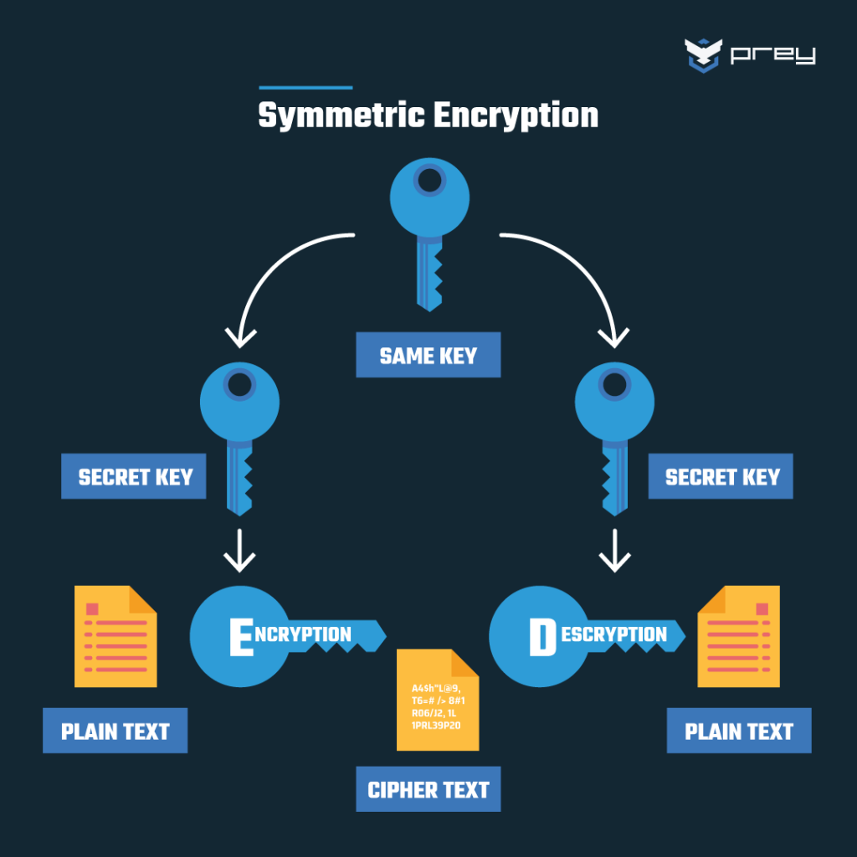
Symmetric Encryption
- Symmetric encryption is a method where the same key is used for both encryption and decryption of data.
- Both the sender and receiver must have a copy of the secret key.
- It is faster and more efficient compared to asymmetric encryption because it involves simpler mathematical operations.
- Examples: AES (Advanced Encryption Standard) and DES (Data Encryption Standard).
- Real-world example: It’s like a lockbox where the same key can lock and unlock it.

Slide 6
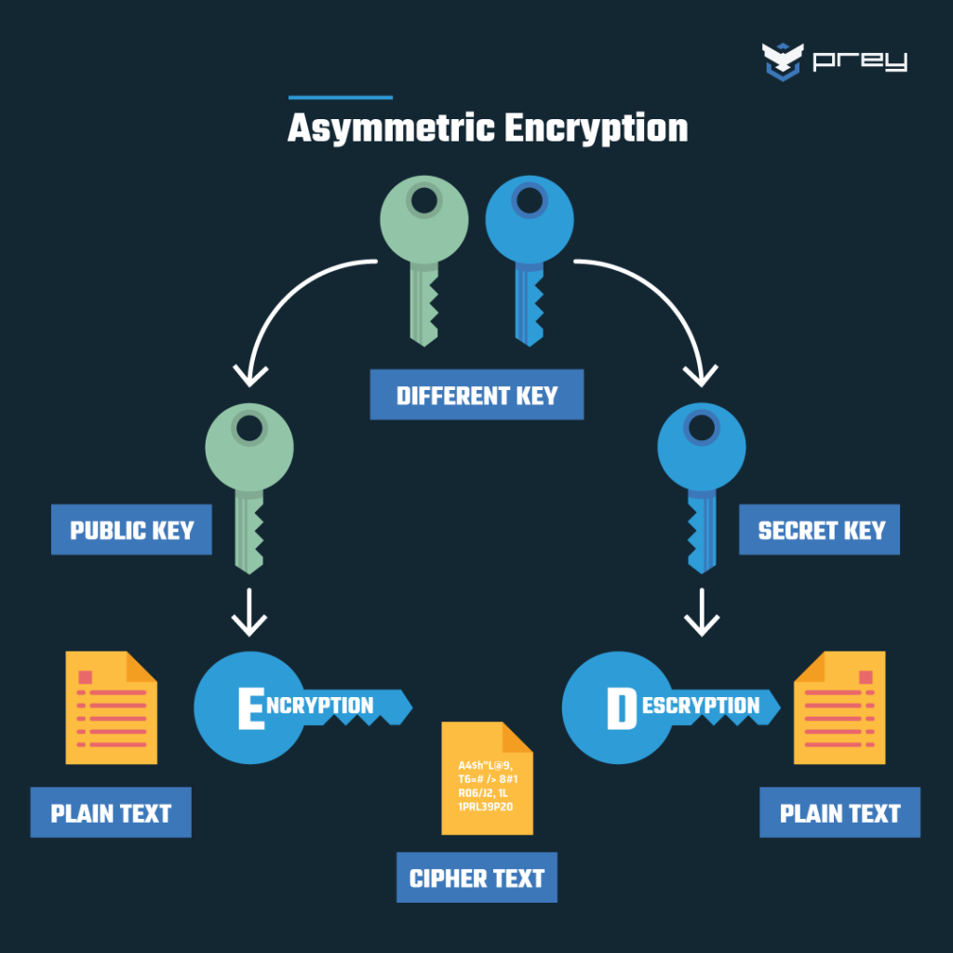
Asymmetric Encryption
-Asymmetric encryption, also known as public-key encryption, uses different keys for encryption and decryption.
- It involves a pair of keys: a public key for encryption and a private key for decryption.
- The public key is freely available to anyone, while the private key is kept secret by the owner.
- It offers greater security but is slower compared to symmetric encryption.
- Examples: RSA (Rivest-Shamir-Adleman) and ECC (Elliptic Curve Cryptography).
- Real-world example: It’s like a mailbox where anyone can drop a letter (encrypt) using the public slot, but only the owner can open (decrypt) it with the private key.

Slide 7
Examples
Cryptography Algorithms
-DES (Data Encryption Standard): This is a symmetric-key algorithm for the encryption of digital data. Although its short key length of 56 bits makes it too insecure for most current applications, it was highly influential in the advancement of modern cryptography.
- RSA (Rivest-Shamir-Adleman): This is one of the first public-key cryptosystems and is widely used for secure data transmission. In such a cryptosystem, the encryption key is public and distinct from the decryption key which is kept secret.
-AES (Advanced Encryption Standard): This is a symmetric encryption algorithm established by the U.S. National Institute of Standards and Technology (NIST) in 2001. It is a block cipher that encrypts data in 128-bit blocks and uses key sizes of 128, 192, or 256 bits.

Slide 8
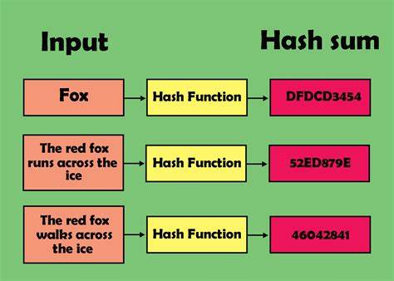
Hash Function
- Hash functions are mathematical functions that take an input of arbitrary length and produce a fixed-size output, called a hash or digest.
- Main properties:
- One-way: It is computationally infeasible to reverse-engineer the original input from the hash value.
- Collision-resistant: It is computationally unlikely to find two different inputs that produce the same hash value.
- Applications include data integrity, digital signatures, and password storage.

Slide 9

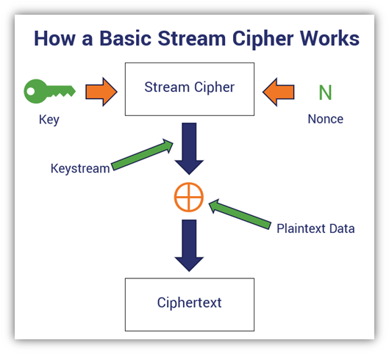

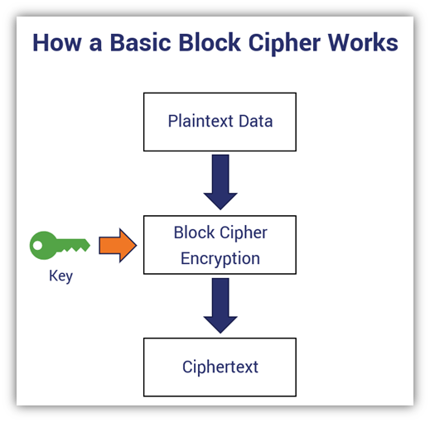
Ciphers
Stream Cipher
- A stream cipher is a type of encryption algorithm that encrypts data one bit or byte at a time.
- It generates a stream of pseudo-random key bits, which are combined with the plaintext using a bitwise XOR operation to produce the ciphertext.
- Stream ciphers are often used for real-time communication and are more efficient for encrypting data streams.
Block Cipher
- A block cipher is a type of encryption algorithm that encrypts data in fixed-size blocks, typically 64 or 128 bits.
- The plaintext is divided into blocks, each of which is encrypted separately using the same key.
- Block ciphers use various modes of operation to encrypt multiple blocks of data securely.
- They are commonly used for encrypting large files and data at rest.

Slide 10
Secure Communication Protocols
Secure communication protocols are vital for safeguarding data during transmission over networks, ensuring confidentiality, integrity, and authenticity of data exchanged between parties.
SSL/TLS (Secure Sockets Layer/Transport Layer Security)
IPsec (Internet Protocol Security)
- Secures IP communications at the network layer.
- Provides confidentiality, integrity, and authenticity for IP packets.
- Enables creation of Virtual Private Networks (VPNs) for secure remote access.
- Provides secure communication over the internet.
- Establishes encrypted connections between clients and servers.
- Verifies server authenticity with digital certificates to prevent man-in-the-middle attacks.
SSH (Secure Shell)
- Used for secure remote access and file transfer.
- Encrypts data exchange between clients and servers.
- Utilizes public key cryptography for authentication, ensuring identity validation.

Slide 11
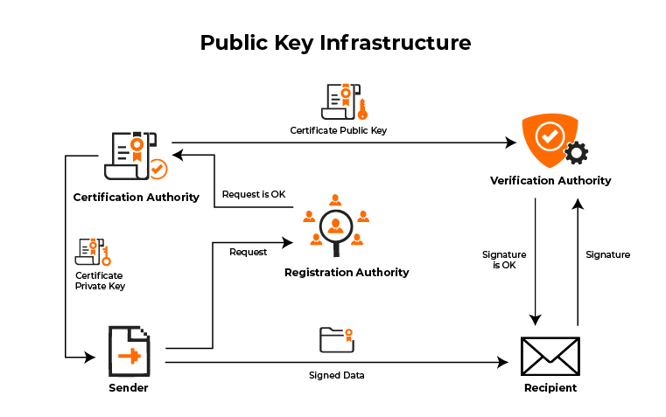

Public Key Infrastructure
- PKI is Framework for managing creation, distribution, and revocation of digital certificates for authentication.
Components of PKI
1. Certificate Authorities (CAs)
- Trusted entities issuing digital certificates.
- Verify identity of certificate applicants.
2. Digital Certificates
- Bind public keys to certificate holder's identity.
- Include holder's name, public key, and expiration date.
Importance of PKI
- Enables secure communication, authentication, and digital signatures by managing cryptographic keys and certificates.
- Ensures users can securely communicate and verify identities in open network environments.
Certificate Revocation and Management
- Invalidates digital certificates before expiration date in case of compromised private keys or changes in certificate holder's identity.
- Effective certificate revocation mechanisms are crucial for maintaining PKI security. Proper certificate management, including renewal and expiration tracking, is essential for maintaining PKI integrity and effectiveness.

Slide 12
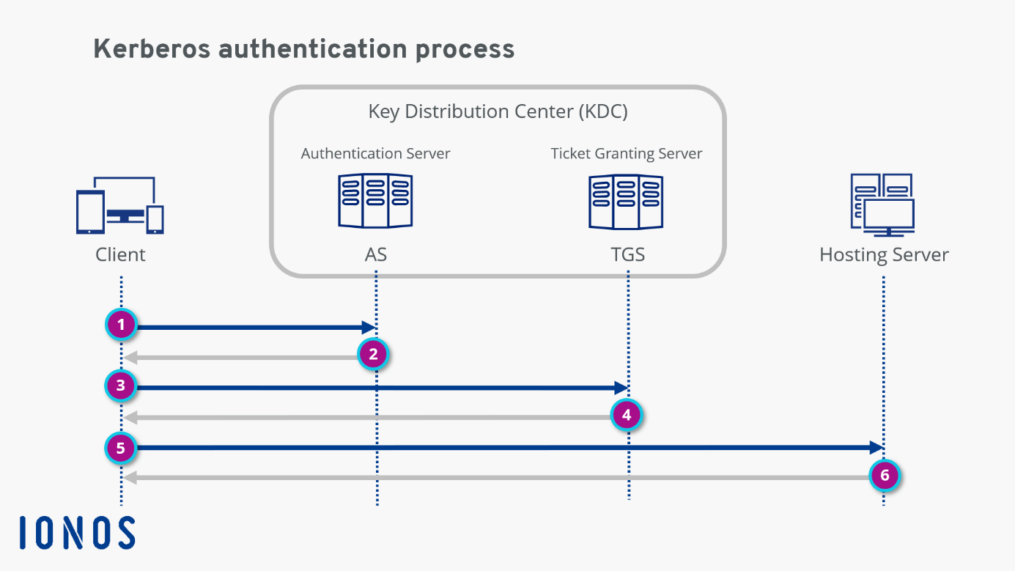
Kerberos
- Kerberos is a computer network authentication protocol that provides the identity of users on a non-secure network.
- It runs on port 88 by default and is based on the Symmetric Key Encryption method.
- It requires a trusted third party and operates based on a ticketing system.
- When a user logs into the network, a session key is generated based on the user’s password.
- This session key is then forwarded to the Ticket Granting Server (TGS).
- The TGS provides a ticket to the user, which is then forwarded to the desired server for authentication.
- The ticket has a timestamp given by the TGS, so it can be used to access various services within a given time.
- Timestamping is done to secure the ticket, preventing its use by an unauthorized user after the given time.

Slide 13
Cryptanalysis
Is the study and practice of analyzing cryptographic systems with the aim of breaking them or discovering weaknesses. It involves various methods and techniques to decipher encrypted messages without knowledge of the cryptographic key. Cryptanalysis focuses on attacking cryptographic systems, finding vulnerabilities, and exploiting them to reveal the underlying plaintext.
1. Brute Force Attacks:
- Brute force attacks systematically try all possible keys to break cryptographic systems.
- Attackers rely on computing power to decrypt encrypted data instead of exploiting encryption algorithm weaknesses.
- They attempt every possible key until finding the correct one, which can be time-consuming and resource-intensive.
- Effective against encryption with small key spaces or vulnerable algorithms.
2.Frequency Analysis:
- Frequency analysis exploits patterns in the frequency of letters or symbols in ciphertext to deduce plaintext.
- By analyzing character frequency distribution, attackers infer information about the plaintext.
- They compare ciphertext frequency distribution to expected frequency distribution in the plaintext language to identify common words or phrases.

Slide 14
Future
Advancements and challenges in cryptography continue with technological progress.
Quantum computing poses a significant threat to traditional cryptographic systems.
Post-Quantum Cryptography:
Aims to develop algorithms resistant to quantum computing threats.
Relies on different mathematical principles like lattice-based or hash-based cryptography.
Advancements in Cryptographic Techniques:
Homomorphic Encryption: Allows computations on encrypted data without decryption.
Zero-Knowledge Proofs: Enhances privacy by proving secrets without revealing them.
Blockchain Technology: Secures transactions and data in decentralized systems, ensuring transparency and integrity.

Slide 15
Conclusion
Cryptography ensures data security and privacy in an interconnected world.
Brute force attacks and frequency analysis underscore the importance of robust encryption and key management.
Emerging trends like post-quantum cryptography and blockchain offer promising solutions.
Continued research and development in cryptography is vital for addressing evolving threats and safeguarding sensitive information.
Further exploration of cryptographic techniques and applications across various domains is encouraged for mitigating risks and protecting against unauthorized access and data breaches.

Slide 16
18th March 2024
THANKYOU
Any Questions?

